Slide 1
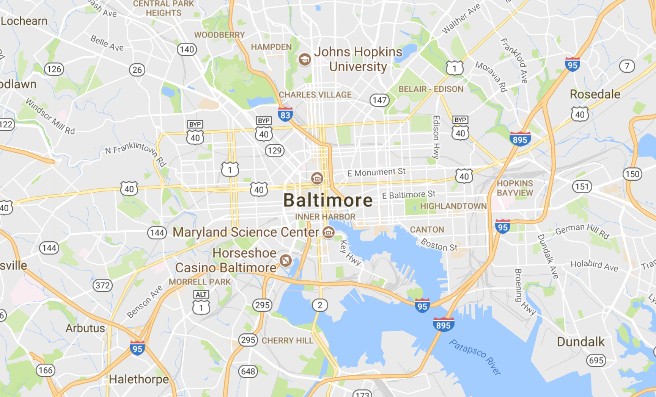
MAP+OPTIMIZE Optimizing Health Care through Transit Mapping
MAPTIMIZE
Joanna Guo, Darius Irani, Jung Min Lee, Ronan Perry, Hadley VanRenterghem

Slide 2


Health Care Deserts
“
Your zipcode affects your health more then your genetic code
”
Notes:
Food deserts are areas where people are 1) live far away from supermarkets, 2) have low income, 3) and do not own vehicles
We are already familiar with the concept of food deserts, but the same concept can be applied to health care as well.

Slide 3
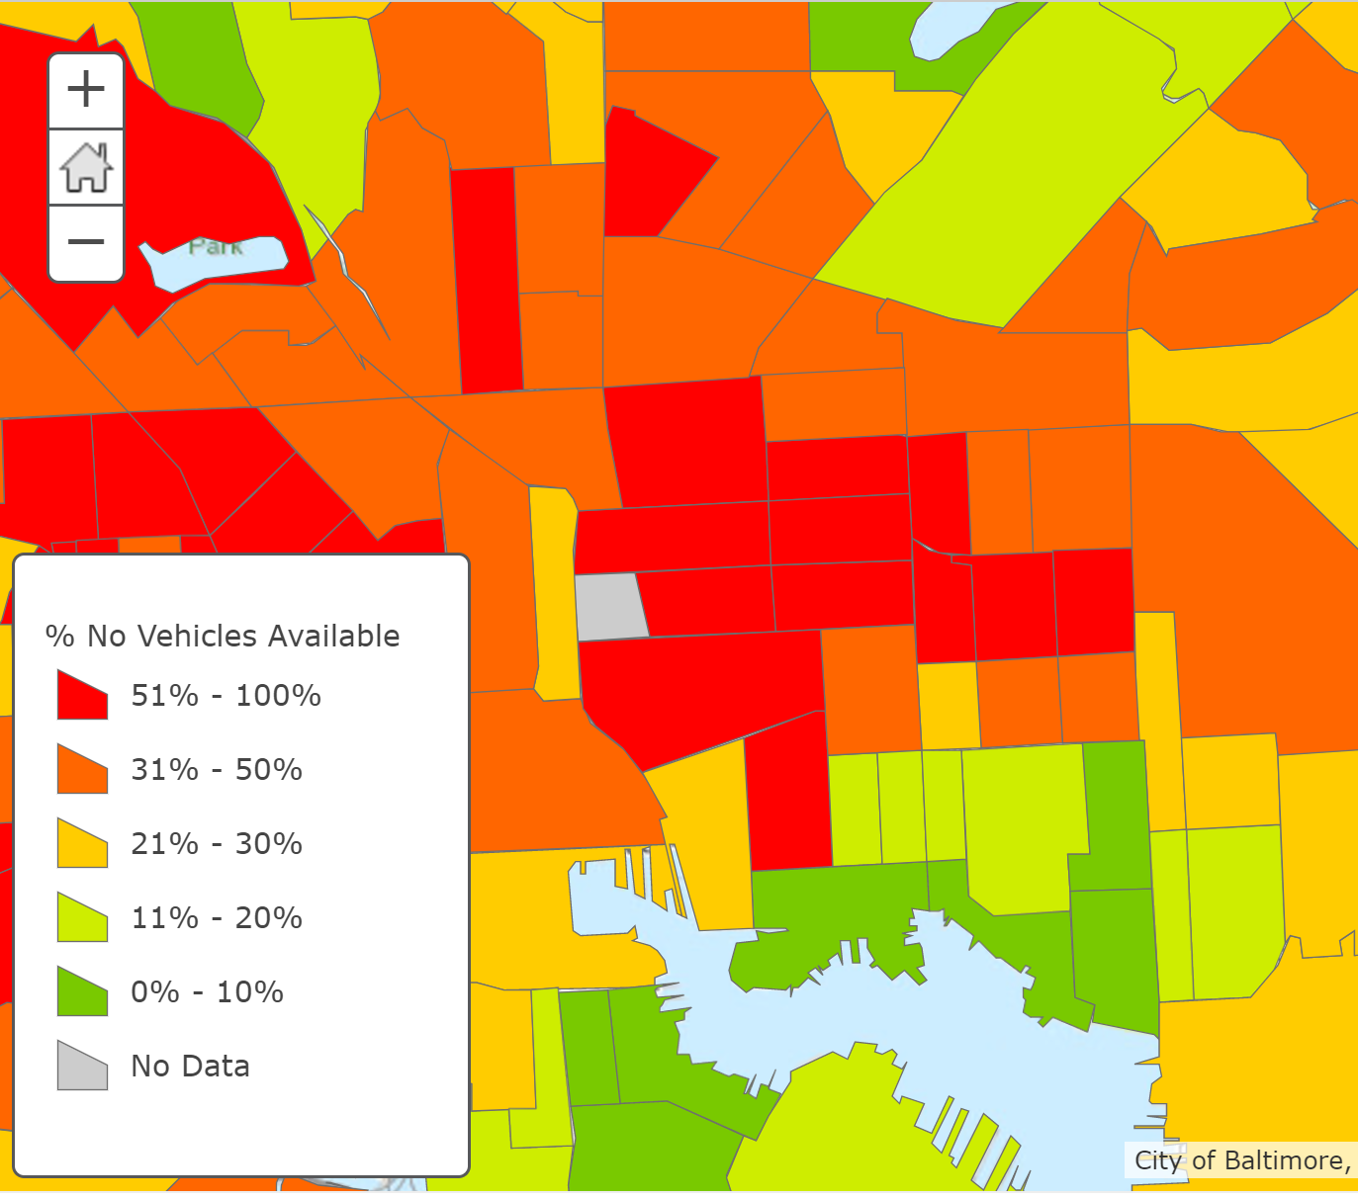
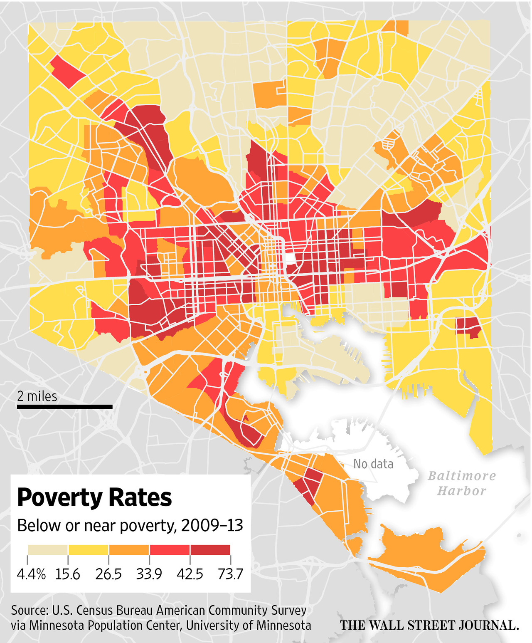
|CASE STUDY: EAST BALTIMORE
High poverty rate
Low income households
Households without vehicles
Walking and public transit
Target Population
Federally qualified community health centers Funds from HRSA to provide primary care services in underserved areas
Target Resource

Slide 4
Identify health deserts in Eastern Baltimore and determine optimal locations for additional health-care resources

Slide 5
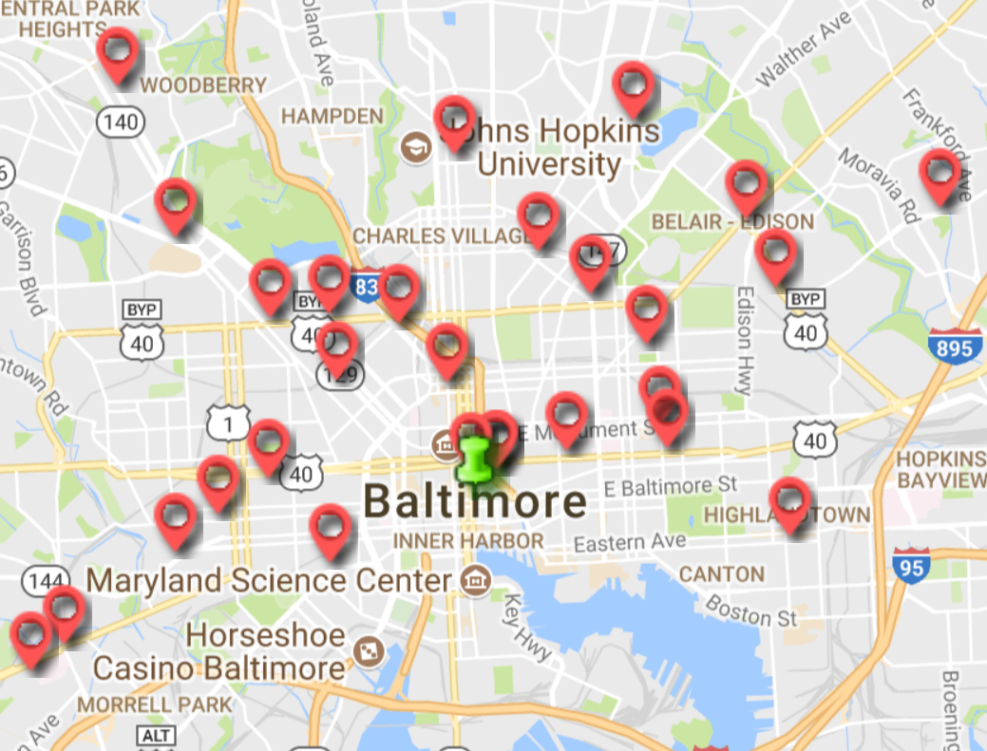
DATA PROCESSING
|LOCATE TARGET RESOURCES
Locate community health centers around East Baltimore and surrounding areas
Total of 23 centers*
* Health Resources & Services Administration (HRSA).

Slide 6
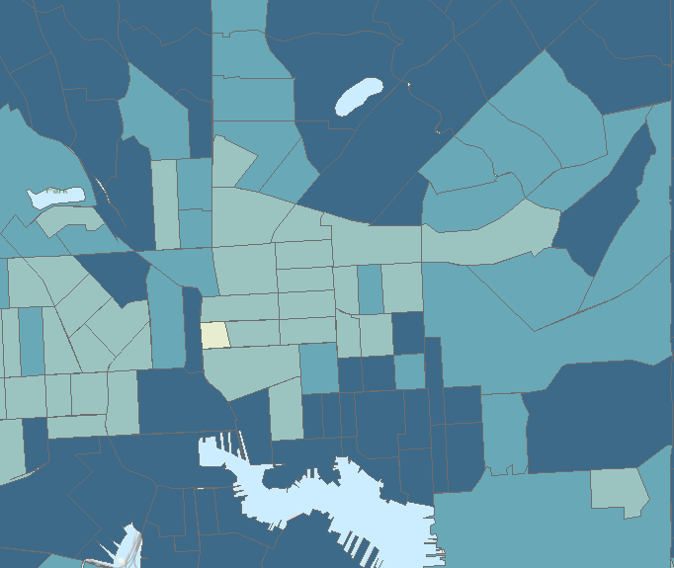

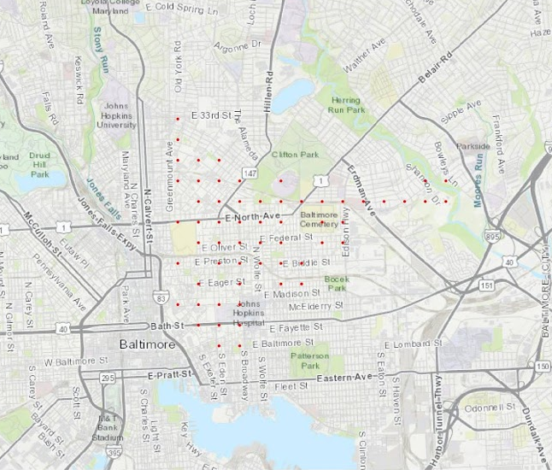

|PINPOINT TARGET POPULATION
Low Income Neighborhoods
2010 American Community Survey 1 year
Median household income < $30,000
% of adults living under federal poverty line > 25%
Use MATLAB to select equally spaced points within the low income neighborhoods
Selected 65 points
Notes:
Median income of US: $49, 445
Median income of Baltimore City: $42, 241

Slide 7
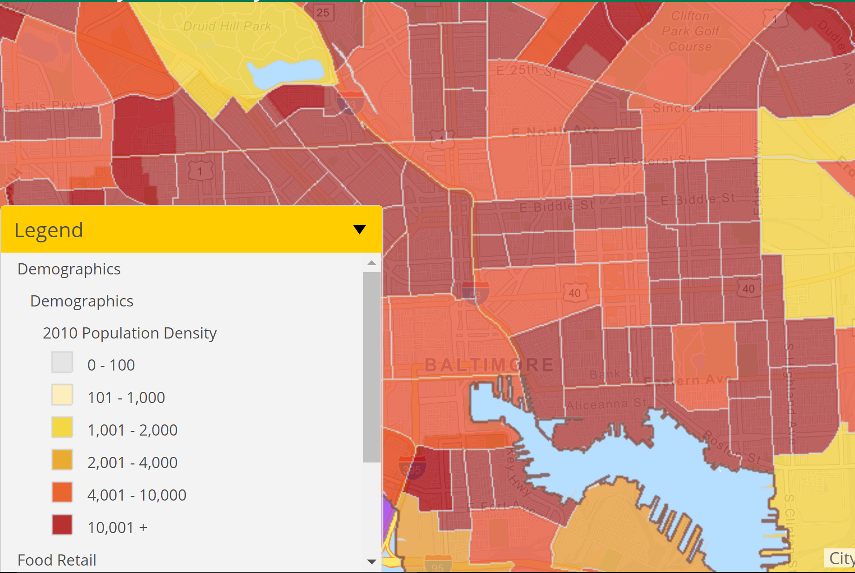
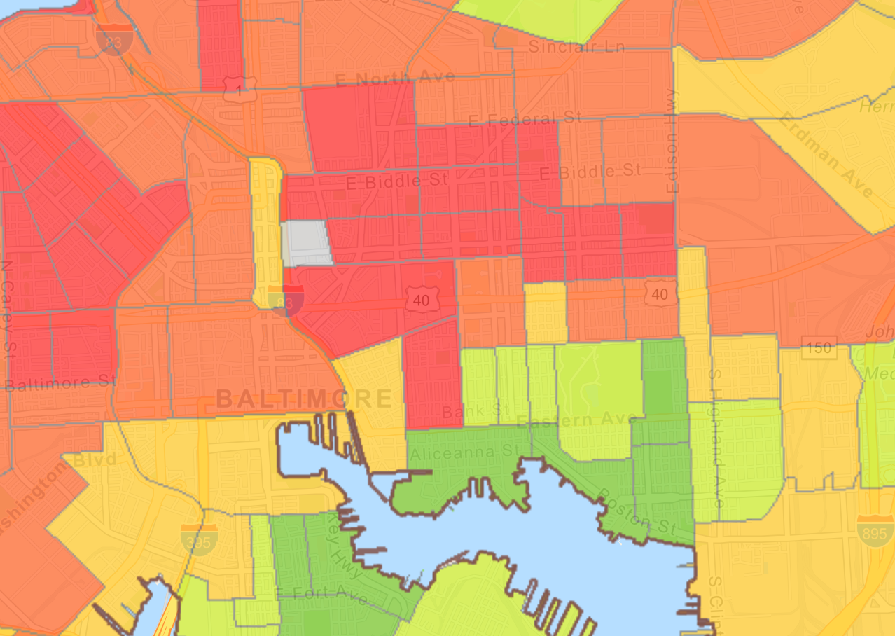
|CALCULATE POPULATION
Map population density and vehicle to selected points of interest
Calculate relevant population at each site People living in low income neighborhoods without vehicles
Population of Interest =
(Population density) * (Grid Area) * (% Population without access to vehicle)

Slide 8



|GENERATE HEAT MAP
1.
Calculate shortest transit time to health center for each point.
2.
Generate scaled heat map of fastest transit time.
3.
Python heat maps and data analysis integrated into backend web development

Slide 9

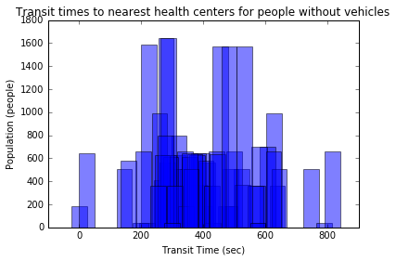
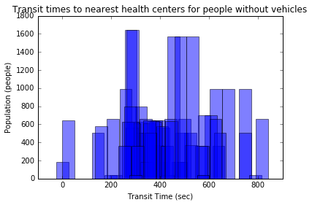
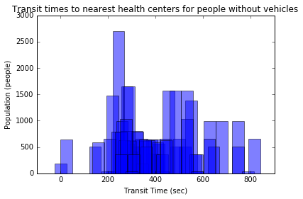

|DETERMINE NEW HEALTHCARE SITE

Slide 10



|STAKEHOLDER BENEFITS
Patients:
Receive affordable care
More convenient access
Enable more frequent visits to health centers
Healthcare Providers:
Minimize burden on individual health centers.
Government:
Maximize impact of federal grant money to health centers
Reduce overall healthcare costs through preventative care

Slide 11


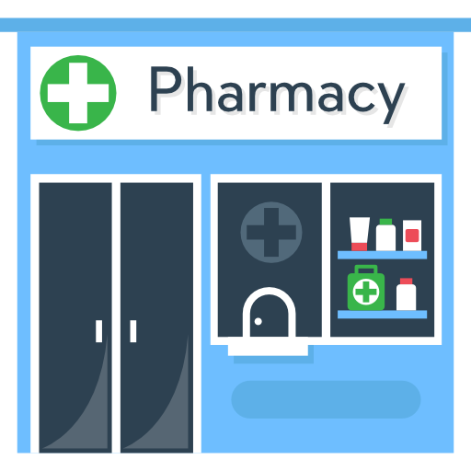

|PLAN FOR EXPANSION
4.
Expand to include other healthcare providers in urban centers.
3.
Target other urban centers using same system.
2.
1.
Add pharmacies to target resources.
Expand our scope to cover all of Baltimore.
Notes:
Use the same data sources to expand our scope and cover all of Baltimore.
Add data on existing pharmacies in Baltimore to also address the issue of pharmacy deserts in Baltimore.
Target other American urban centers using same system of tracking HRSA health centers.
Expand to include diverse forms of healthcare providers in American urban centers.

